Slide 1
THE WRITING PROCESS
writing is a process
of inquiry—
it grows and changes over time

Slide 2
Perceptions of the Writing Process
If I just follow all the steps in the proper sequence, then I will come out with a good paper (like a paint by numbers picture). Writing happens in a linear fashion.
Writers start writing when they have everything figured out.
Some got it; I don’t--the genius fallacy.

Slide 3
More Perceptions of the Writing Process
When you write, you should get it right the first time.
Good grammar is good writing; bad writing is bad grammar.
Good writers work alone—the lone wolf syndrome.

Slide 4
THE REALITY
Writing is a dynamic, organic act (it is NOT like a paint by numbers painting). This “linear” perception of writing is artificial (created by teachers and textbooks explaining the process).
Writers don’t have it all figured out when they start to write.
Writing is a skill and a craft that can be developed.

Slide 5
The Reality
No writer gets his or her text “right” the first time. It takes many cycles of adjusting, and adding, and trimming, and fixing to get it right.
Although good grammar is important, there is more to good writing than correctness.
Writers often rely on others for ideas and help. Some texts even are co-authored.

Slide 6
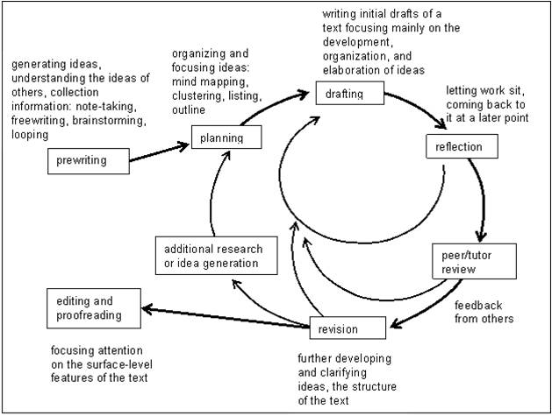
Writing is “recursive”
As we write we may jump “ahead” to a later “stage” of the writing process, or late in the process we may go back to the drawing board and do more prewriting.
The writing process jumps ahead or leaps behind--it is not linear.
Perhaps we should say “phases” and not “stages” (to avoid the linear fallacy)—phases that can by cycled and recycled into at any point in the writing process.
A diagram of the recursive writing process

Slide 7
So how do we reconcile ourselves to the view of writing as a linear “process”?
Think about where writer’s block comes from.

Slide 8
When we write we do 2 things
We are creative.
We are critical

Slide 9
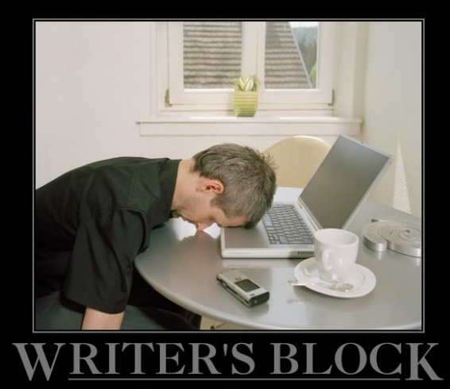
Problems come
When we try to be critical as we are being creative.
The critical tends to cancel the creative out.

Slide 10
To avoid writer’s block (and still see some “phases” to the writing process)
Separate the creative and the critical activities.
Begin in a “creative phase” where you don’t care if it is “wrong.”
Then come back with your “critical” cap on.

Slide 11
The Writing Process
Creative Activities
Prewriting
Brainstorming
listing
data gathering
free writing
questioning
cubing
drafting.
Critical Activities
Revision
Sorting, Organizing, Outlining
More careful drafting
Editing
Proofreading

Slide 12
Another View of the Writing Process
The “cognitive” view.
Writing is best understood as a set of distinctive thinking processes which writers orchestrate or organize during the act of composing.

Slide 13
Goal-directed Thinking Process
The act of composing itself is a goal-directed thinking process, guided by the writer’s own growing network of goals.
The act of developing and refining one’s goals is not limited to a “pre-writing stage” but is bound up with the ongoing, moment-to-moment composing process.

Slide 14
Problem solving
“People only solve the problems they define for themselves”
Writing involves a complex series of problems to solve—how do I create an engaging opener?; —how can I make my support in this paragraph stronger? —how can I get the documentation correct?

Slide 15
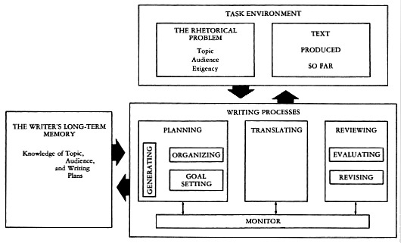
Flower and Hayes’ Cognitive Model of the Writing Process

Slide 16
The Writing Situation
Studies have shown that one of the most crucial and important steps in the composing process is to analyze and define the “writing situation”:
What do I want to say? (message)
Who do I want to say it to? (audience)
Why do I want to say it to them? (purpose)
Time spent figuring out the writing situation, and your rhetorical stance within it, is time well spent.

Slide 17
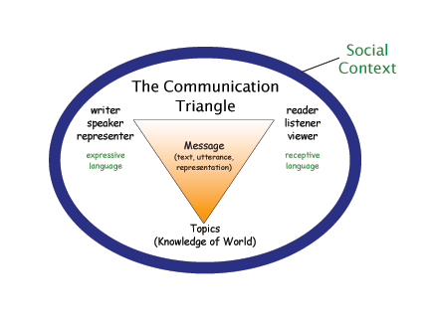
Images of the Writing Situation
Kinneavey’s Communication Triangle

Slide 18
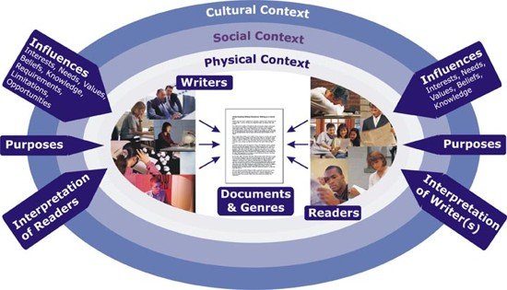
Images of the Writing Situation

Slide 19
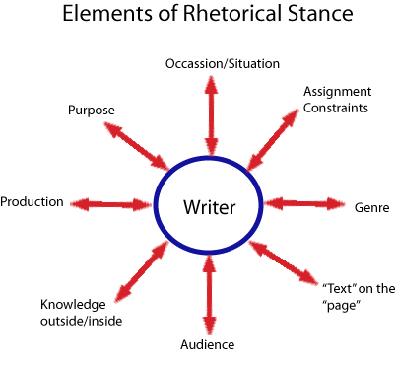
Images of the Writing Situation

Slide 20
See Writing as an Event
One fruitful way of conceiving writing is as an event or occasion. Writing happens within a particular occasion and place before others who are listening and who can respond. Writing then is a form of dialogue and communication within this context.

Slide 21
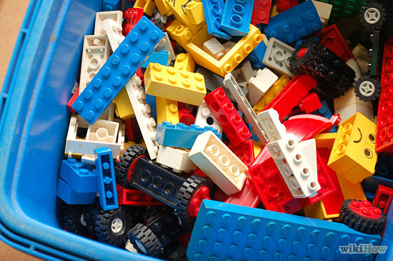
Donald Murray’s View of the Writing Process
Collect
Plan
Develop
The Lego Construction View of the Writing Process

Slide 22
Collect
Effective writing is produced from an abundance of specific information. The writer needs an inventory of facts, observations, details, images, quotations, statistics—all sorts of forms of information—from which to choose when building an effective piece of writing.
It is also information that breeds ideas. Specifics make contact with each other and become an idea. Two and two in writing add up to seven.

Slide 23
Plan
The most important writing usually takes place before there is writing—at least what we usually think of as writing (the production of a draft).
--testing, playing, experimenting, sketching, designing
“Writing off the page”—N Atwell

Slide 24
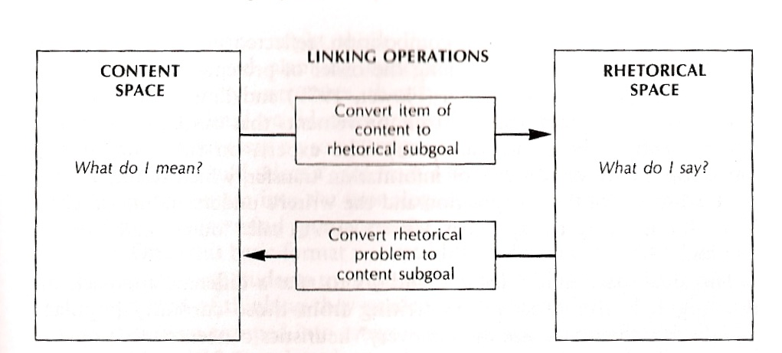
Develop
When the writer’s vision confronts the reality of the text. Carrying out in writing the plan developed.

Slide 25
When Considering Writing Is it a successful piece of writing? Does it work?
Has it achieved its desired effect on the intended audience?
Is it true?
Is it correct?

